Slide 1
AppVerse AI
Smart App Marketplace & Analytics Platform
Spring Boot 3.2
React.js 18
MySQL 8
JWT Security
Presented by: Harini VS
Mentored by: Javeed-Trainer
Great Learning | JFS React Capstone Project
Notes:
Say: "Good morning sir, my name is Harini VS. My capstone project is AppVerse AI — a Smart App Marketplace built with Spring Boot 3.2 for backend, React.js 18 for frontend, MySQL 8 as the database, and JWT for authentication."

Slide 2
2. Project Overview
What is AppVerse AI and who uses it?
What We Built
USER
AppVerse AI is a full stack web application that works like Google Play Store. Users can browse, download and review apps. Developers publish and manage their apps. Admins control the entire platform including users, categories, and reviews.
Browse, download & review apps
DEVELOPER
Problems Solved
Publish apps & view analytics
No centralized platform for discovering apps
Reviews had no automated quality classification
ADMIN
Developers lacked analytics for their apps
Manage entire platform
No easy way to find trending popular apps
AppVerse AI | Harini VS | Great Learning Capstone
Notes:
Say: "AppVerse AI works like Google Play Store. I built it with 3 user roles. USER can browse and download apps. DEVELOPER can create and manage apps and see analytics. ADMIN manages the whole platform. The problems I solved include no automated review sentiment detection and no download analytics for developers."

Slide 3
3. Technology Stack
Backend and frontend tools used
Backend
Frontend
Spring Boot 3.2
React.js 18
REST API framework
Component-based UI
Spring Security
React Router DOM 6
Auth & authorization
Client-side routing
Spring Data JPA
Axios
ORM, no SQL needed
HTTP client with interceptors
MySQL 8
React Toastify
Relational database
Toast notifications
JJWT 0.11.5
Context API
JWT token library
Global auth state
BCrypt
CSS-in-JS
Password encryption
Inline component styling
SLF4J
Logging to file
AppVerse AI | Harini VS | Great Learning Capstone
Notes:
Say: "For backend I used Spring Boot 3.2 with Spring Security and JWT for authentication. Spring Data JPA handles all database operations without writing SQL. MySQL 8 stores all data. For frontend I used React.js 18 with React Router for navigation, Axios for API calls with request interceptors that automatically add the JWT token, and Context API to manage the logged-in user globally."

Slide 4
4. System Architecture
REST MVC Layered Architecture — how all parts connect
React Frontend (localhost:3000)
Request Flow
Login | Browse Apps | Developer Console | Admin Panel | Analytics
1
HTTP Request + JWT Bearer Token
2
Spring Boot Backend (localhost:8080)
3
JwtAuthFilter -> Controller -> Service -> Repository -> Entity
4
JDBC Connection
5
MySQL Database (localhost:3306) Database: appverse_db
8 Tables: users | app | category | review | download | app_version | developer_profile | recommendation
AppVerse AI | Harini VS | Great Learning Capstone
Notes:
Say: "I followed a 4-layer REST MVC architecture. React frontend runs on port 3000 and calls Spring Boot on port 8080. Every single HTTP request first passes through JwtAuthFilter which validates the JWT token. Then it reaches the Controller layer, which calls the Service layer where all business logic is. Service calls Repository which runs JPA queries on MySQL running on port 3306. All 8 tables are there in the appverse_db database."

Slide 5
5. Modules Implemented
8 backend modules — all with Controller, Service, Repository, Entity layers
Authentication & Users
App Marketplace
Developer Console
Reviews & Ratings
Register, login, JWT token, 3 roles
Browse, search, filter by category
Create, update, delete apps + versions
Star ratings 1-5 with validation
Download Tracking
Developer Profile
Recommendations
Admin Panel
Records each download, updates count
Company name, website, bio
Personal app lists with score 0-10
Full user/app/category management
AppVerse AI | Harini VS | Great Learning Capstone
Notes:
Say: "I implemented exactly 8 modules. Each module follows the same 4-layer structure — Controller receives the HTTP request, Service has the business logic, Repository talks to MySQL, and Entity is the database table class. The main modules are Authentication, App Marketplace, Developer Console, Reviews, Download Tracking, Developer Profile, Recommendations, and Admin Panel."

Slide 6
6. Key AI & Analytics Features
3 advanced features added beyond the core modules
Review Sentiment Analysis
01
When user posts a review, analyzeSentiment() runs automatically
Checks negative words: bad, worst, terrible, hate, awful...
Checks positive words: amazing, great, excellent, love, best...
Stored as POSITIVE / NEGATIVE / NEUTRAL in review table
If positive > negative -> POSITIVE (green badge)
Colored badge shown on App Details page for each review
Download Analytics Dashboard
02
Every download saved with user ID, app ID, timestamp
GET /api/downloads/analytics returns per-app counts
App total_downloads field auto-incremented on each download
Developers see ranked list of apps by download count
Trending Apps on Home Page
03
GET /api/apps/trending endpoint in AppController
Shown as horizontal scrollable cards on Home page
Sorts all apps by totalDownloads DESC, returns top 5
Each card shows rank number and total download count
AppVerse AI | Harini VS | Great Learning Capstone
Notes:
Say: "I implemented 3 extra features on top of the 8 modules. First is Sentiment Analysis — the analyzeSentiment() private method in ReviewServiceImpl automatically checks every review comment for positive and negative keywords and stores POSITIVE, NEGATIVE, or NEUTRAL in the database. This shows as a colored badge. Second is Download Analytics — every download is recorded and developers can see a ranked list of their apps by download count. Third is Trending Apps — the backend sorts all apps by totalDownloads and returns the top 5 which appear on the home page."

Slide 7
7. Security — JWT & Role-Based Access Control
How authentication and authorization work
JWT Authentication Flow
Role-Based Access Control
1
User sends email + password -> POST /api/users/login
USER
Backend finds user by email from MySQL
Browse & search apps
Write reviews
2
Download apps
View my downloads
3
BCrypt.matches() compares password with stored hash
DEVELOPER
4
JwtUtil generates token (email + 10hr expiry + signature)
All USER actions
Add app versions
Create / edit / delete apps
View analytics dashboard
5
React stores token in localStorage via AuthContext
ADMIN
6
Every request: Authorization: Bearer <token>
All actions
Manage categories
7
JwtAuthFilter validates -> allows or returns 401
Manage all users
Delete any review
AppVerse AI | Harini VS | Great Learning Capstone
Notes:
Say: "Security uses JWT. When you login, backend generates a signed token. React stores it in localStorage. Axios request interceptor automatically adds this token to every single API call in the Authorization header as Bearer token. JwtAuthFilter runs on every request, validates the token using the same secret key. If invalid or expired it returns 401. For authorization I have Role-Based Access Control. USER can browse and download. DEVELOPER can create apps and see analytics. ADMIN manages everything. Wrong-role access shows an Unauthorized page."

Slide 8
8. Database Design — 8 MySQL Tables
JPA entities with relationships — created automatically on startup
users
app
category
id PK AUTO_INCREMENT
id PK
id PK
name NOT NULL
name NOT NULL
name UNIQUE NOT NULL
email UNIQUE NOT NULL
description
description
password (BCrypt hashed)
icon_url
role ENUM: USER/DEVELOPER/ADMIN
avg_rating FLOAT
total_downloads BIGINT
review
download
app_version
developer_id FK -> users
id PK
category_id FK -> category
id PK
id PK
comment NOT NULL
downloaded_at DATETIME
version_name
rating 1-5
user_id FK -> users
release_notes
sentiment POSITIVE/NEGATIVE/NEUTRAL
app_id FK -> app
release_date
user_id FK
app_id FK -> app
app_id FK
Key Relationships: User 1:1 DeveloperProfile | User 1:N App | Category 1:N App | App 1:N Review, Download, AppVersion
AppVerse AI | Harini VS | Great Learning Capstone
Notes:
Say: "I have 8 MySQL tables. The 6 main ones are users, app, category, review, download, and app_version. Plus developer_profile and recommendation. All tables are created automatically by Spring Boot JPA with ddl-auto=update — this means tables are created on first run and data is NEVER deleted when I restart. The key JPA relationships are User OneToOne DeveloperProfile, Category OneToMany App, App OneToMany Review and Download and AppVersion."

Slide 9
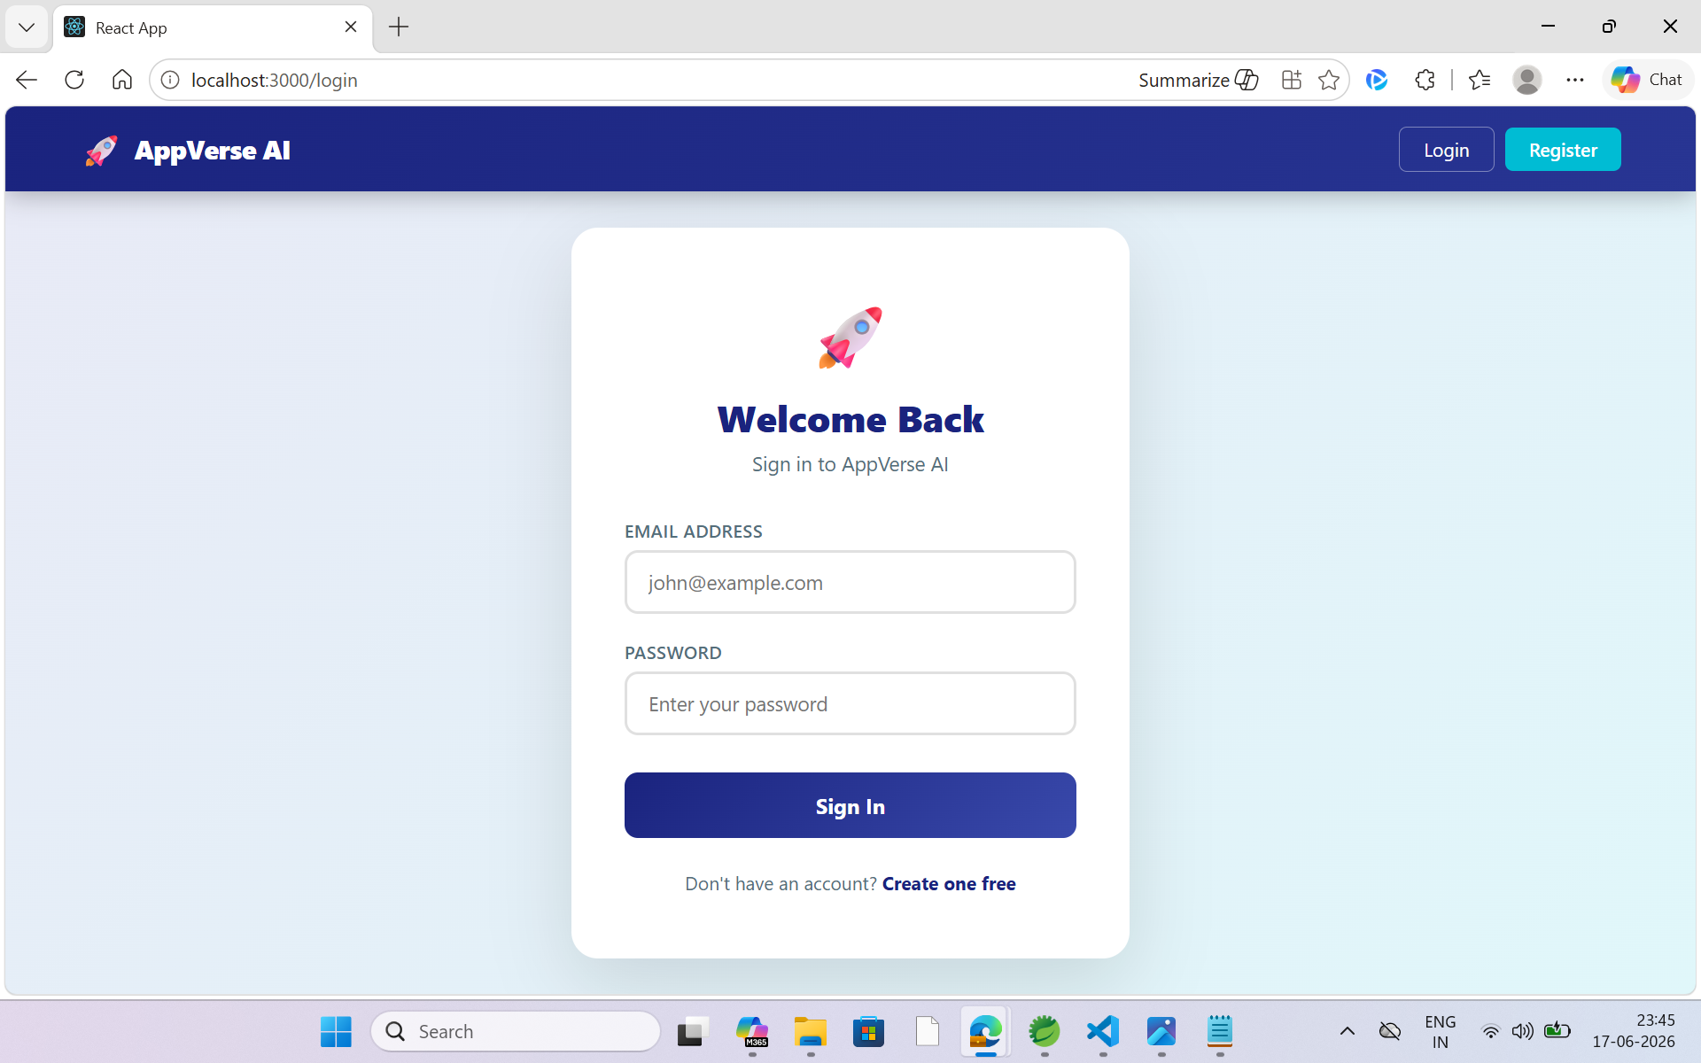

Slide 10
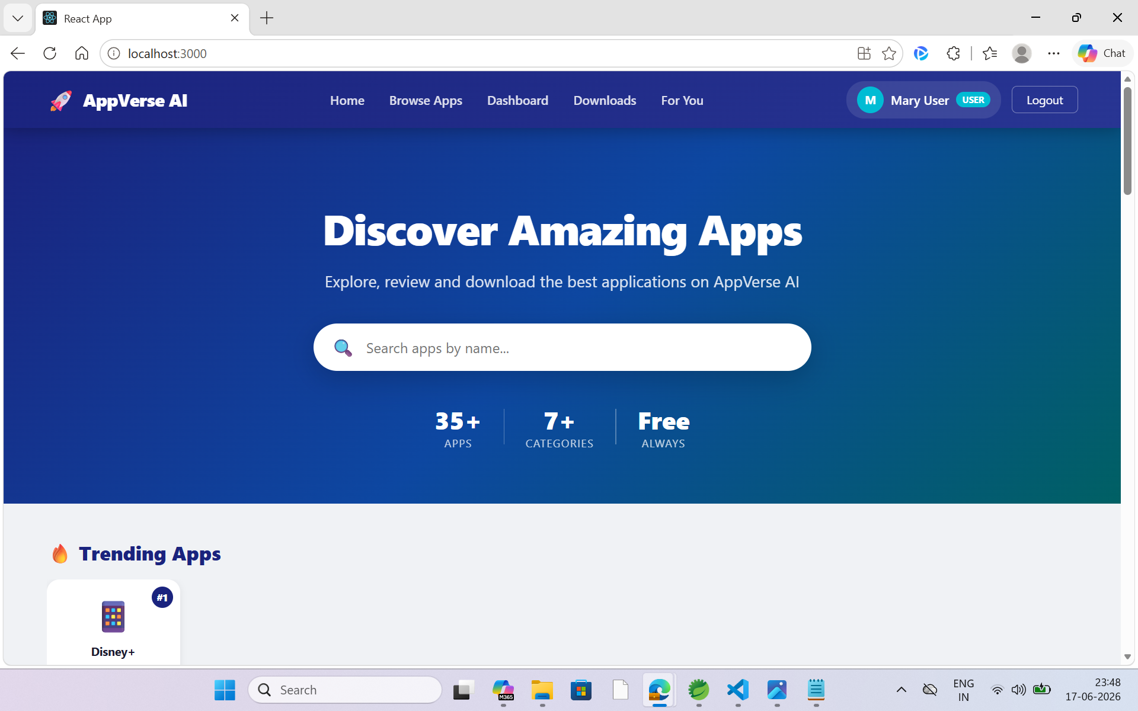

Slide 11
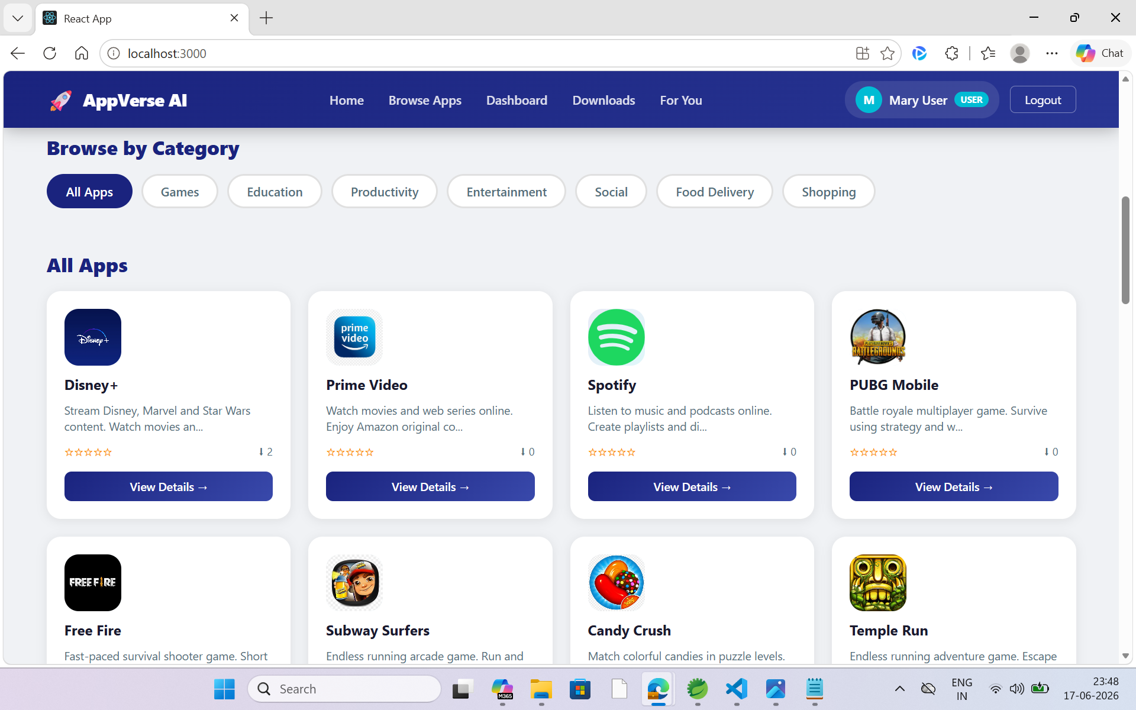

Slide 12
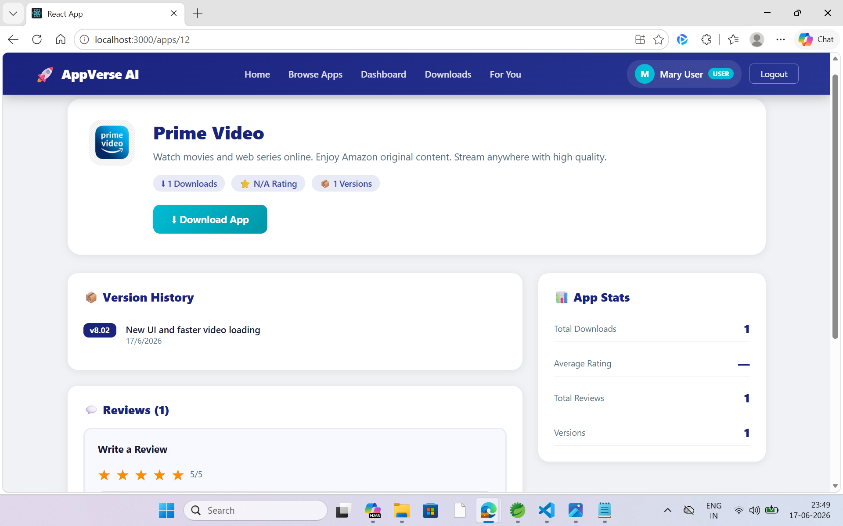

Slide 13
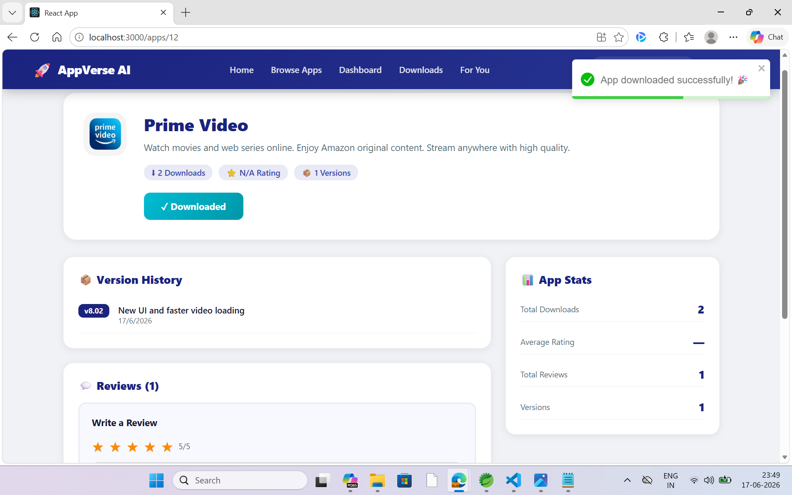

Slide 14
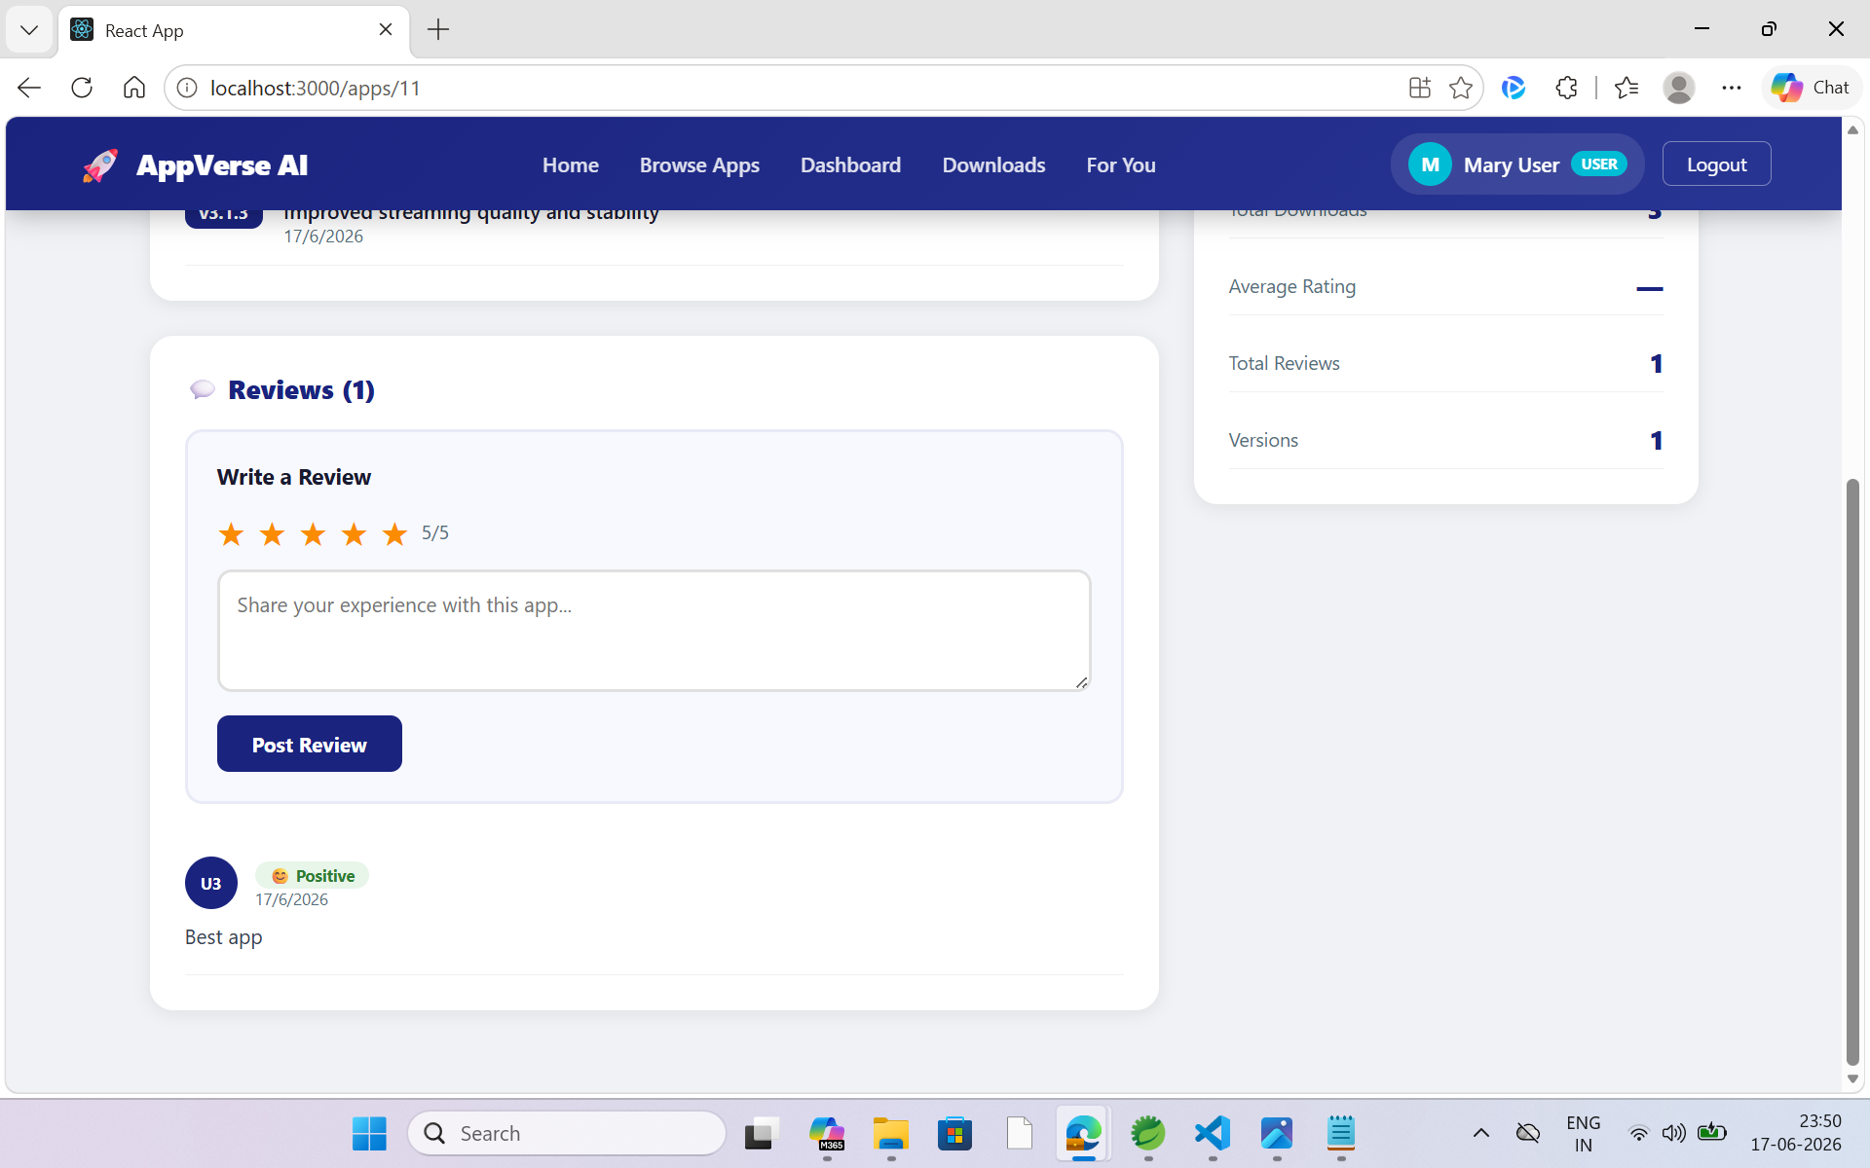

Slide 15
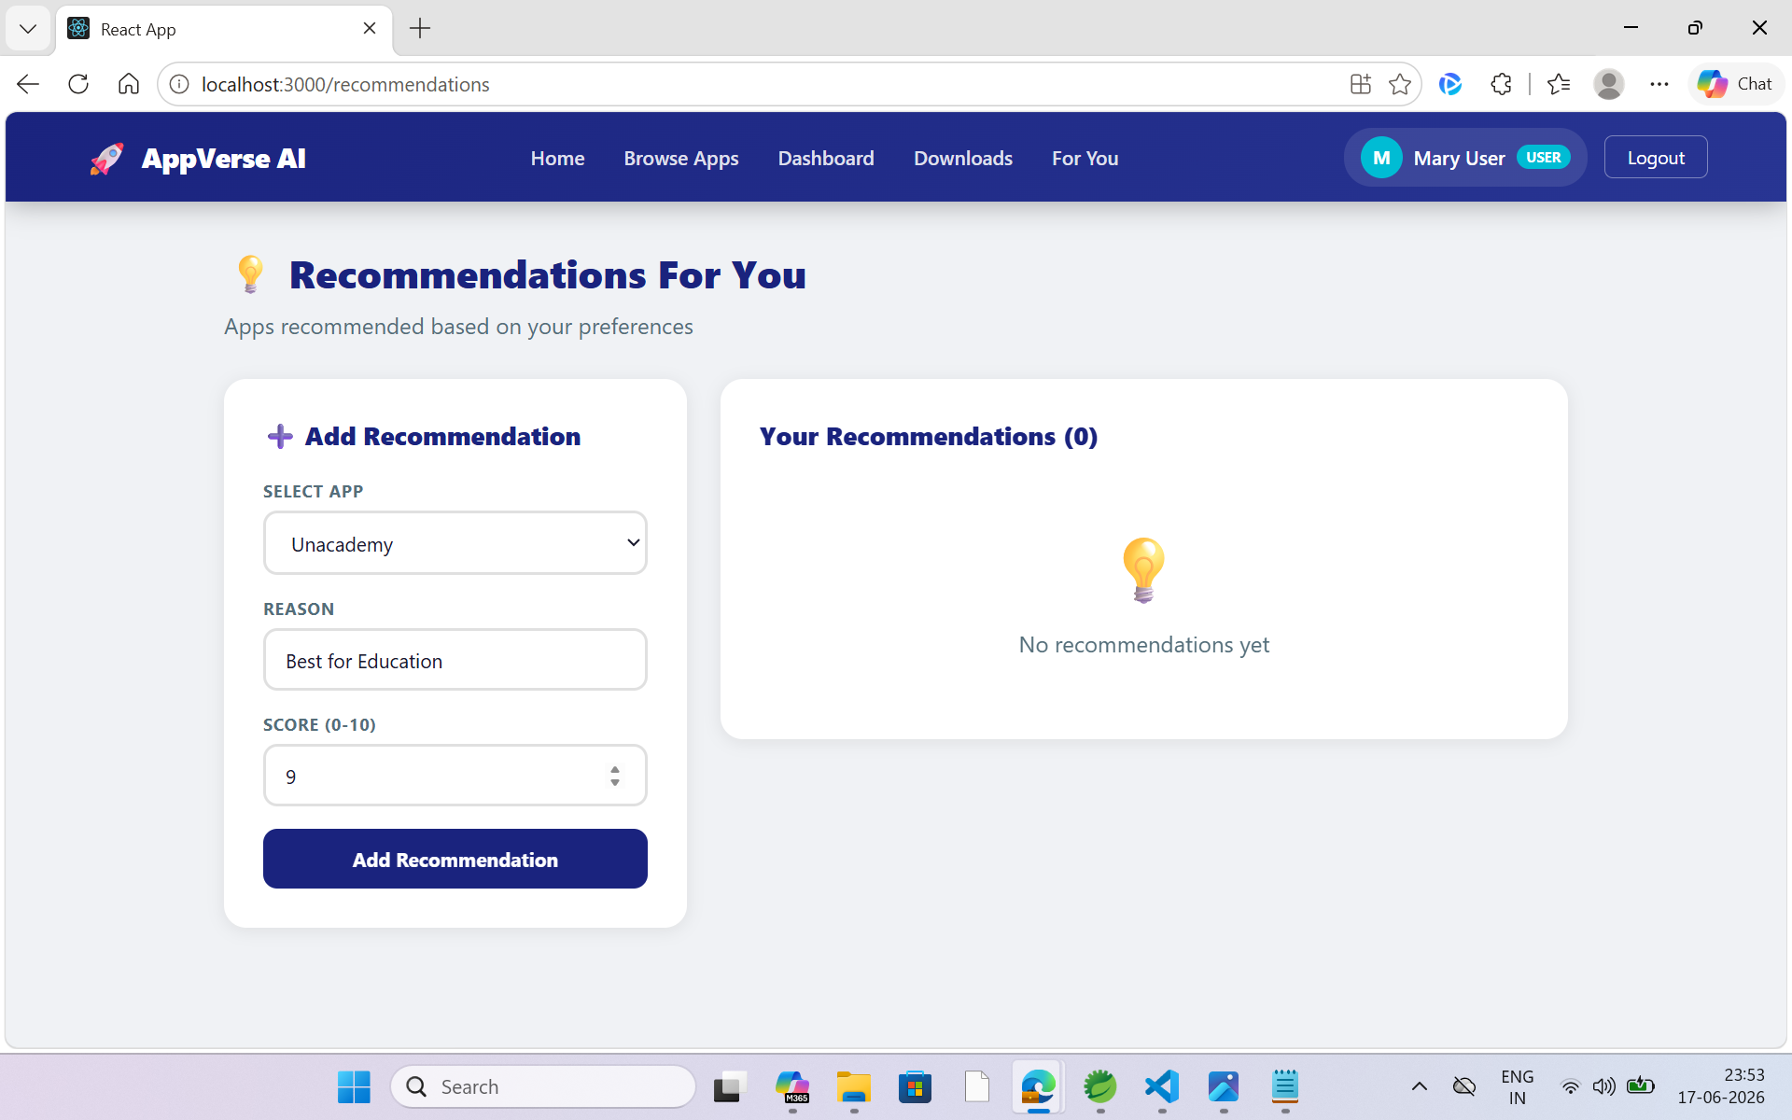

Slide 16
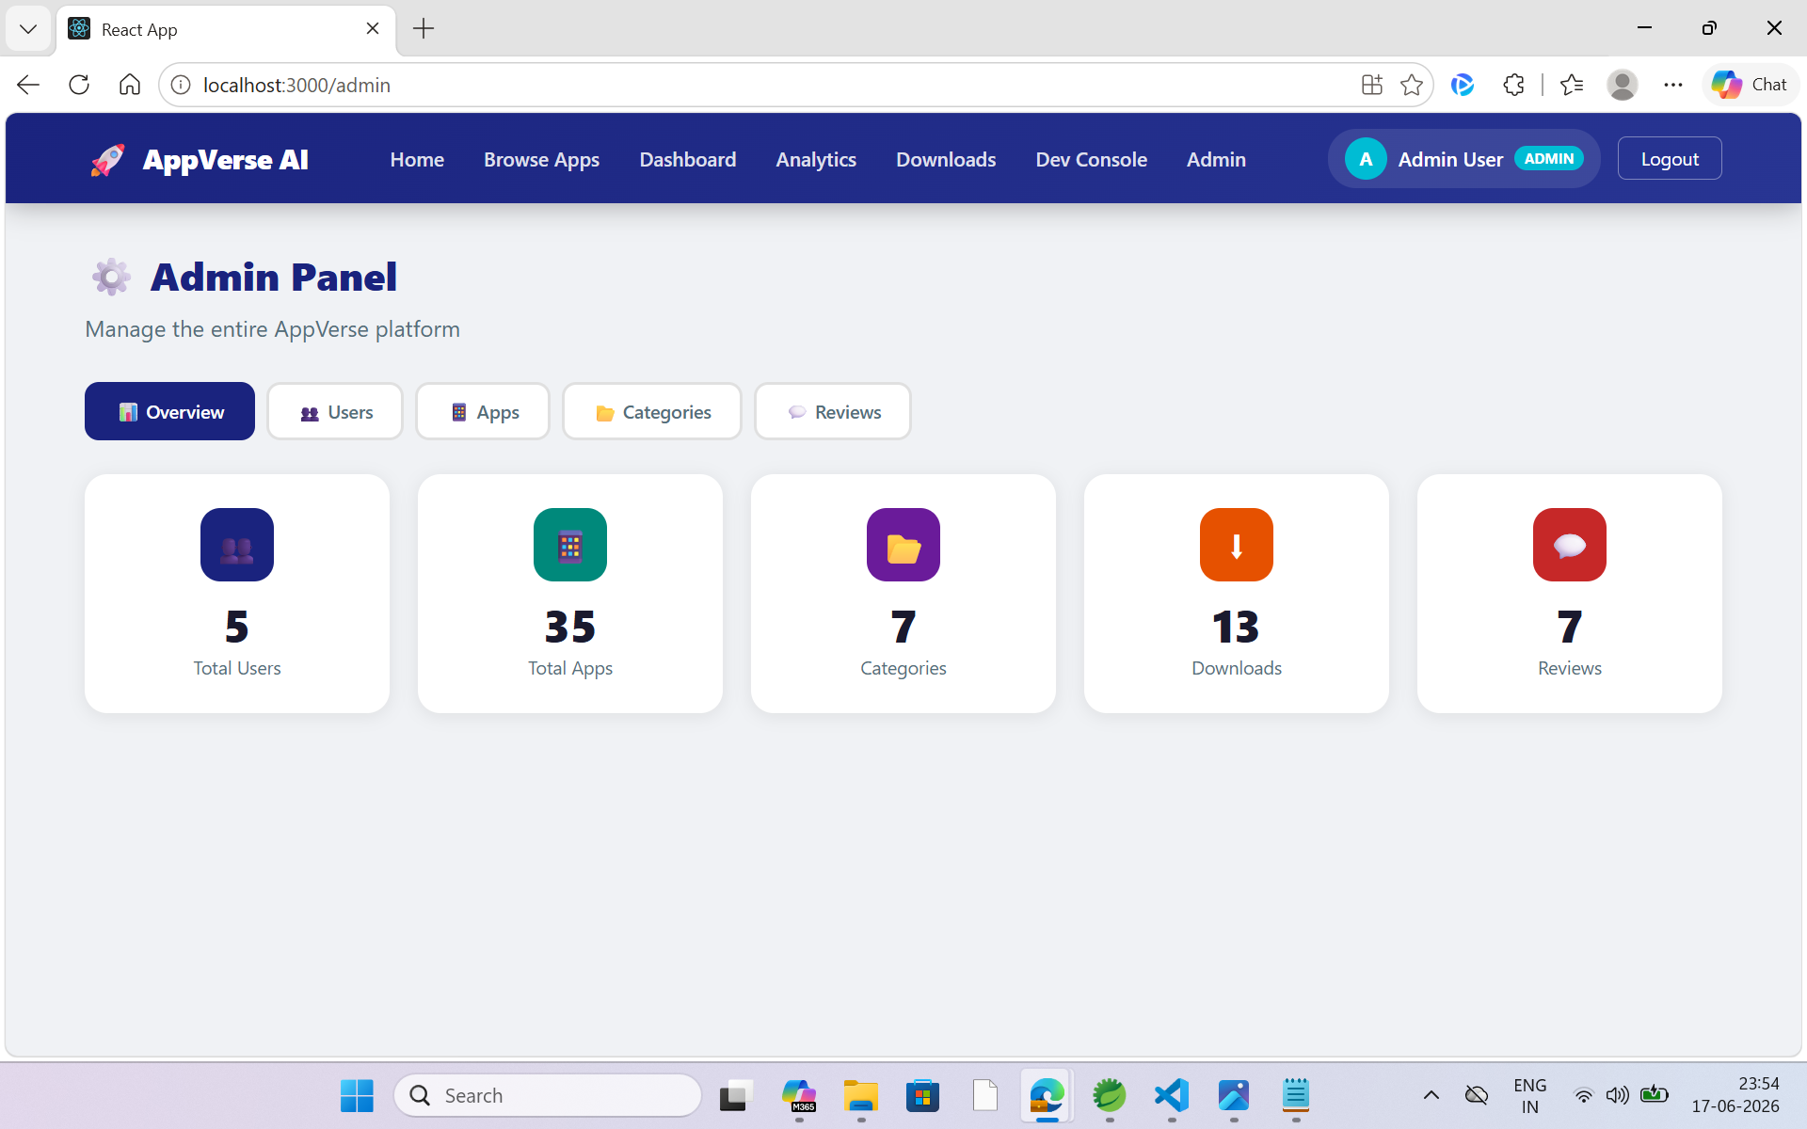

Slide 17
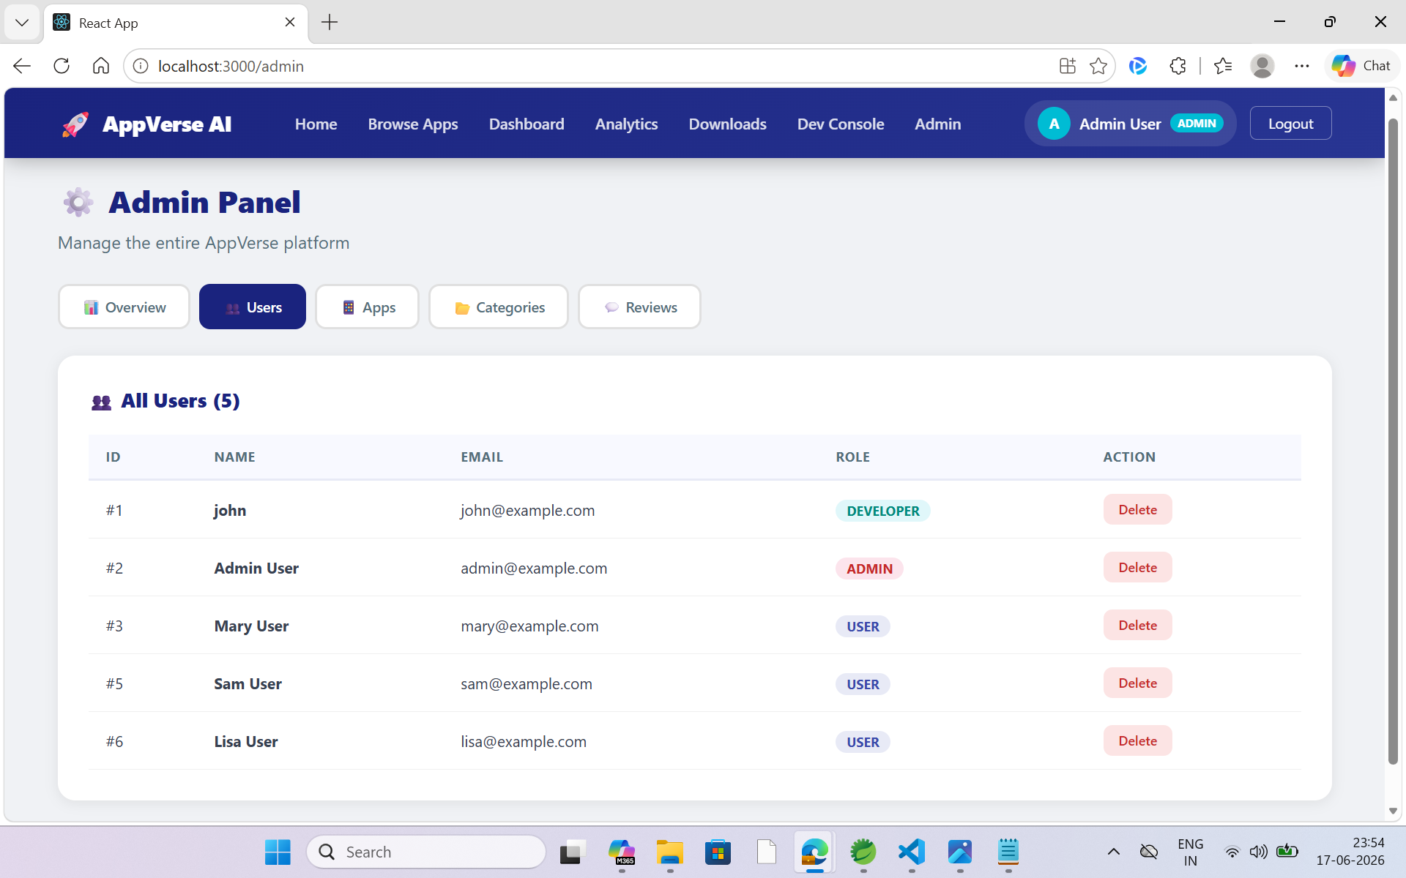

Slide 18
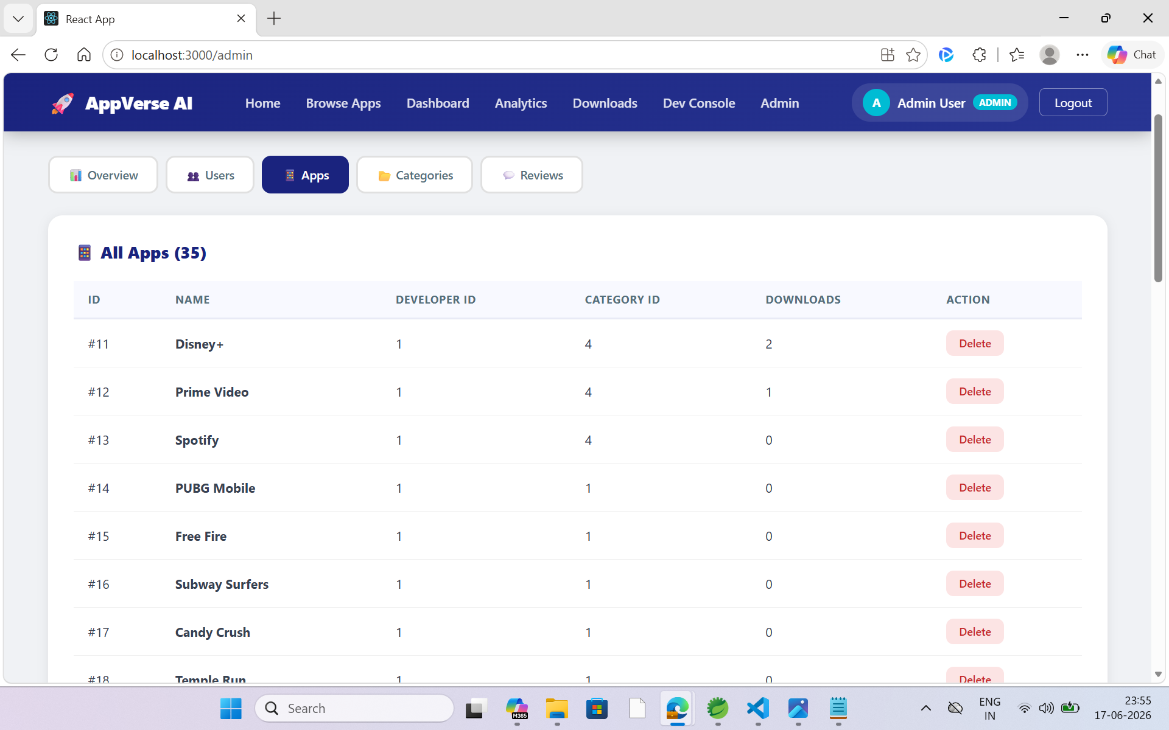

Slide 19
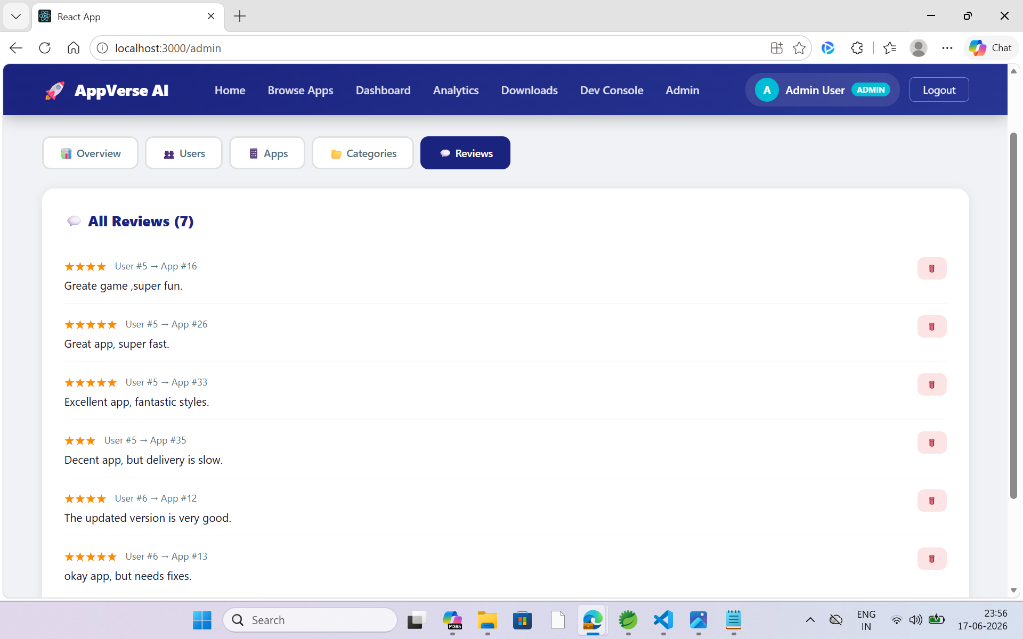

Slide 20
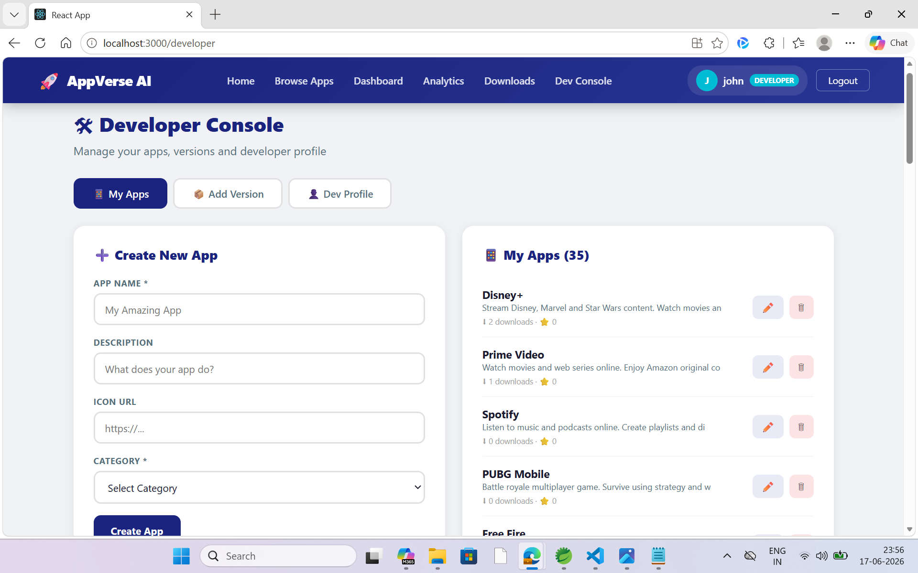

Slide 21
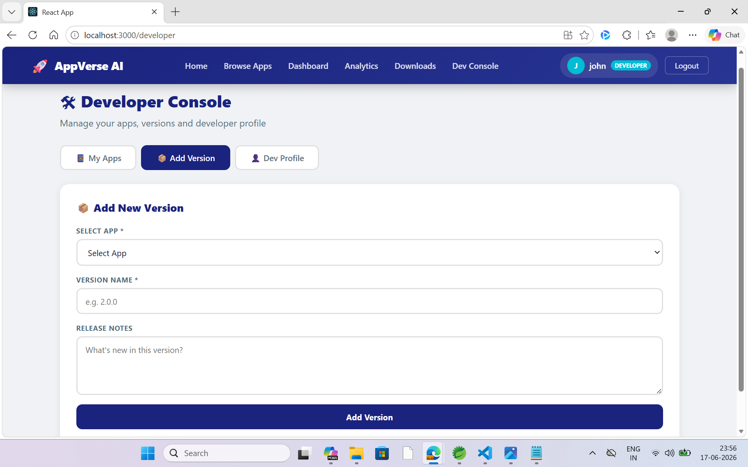

Slide 22
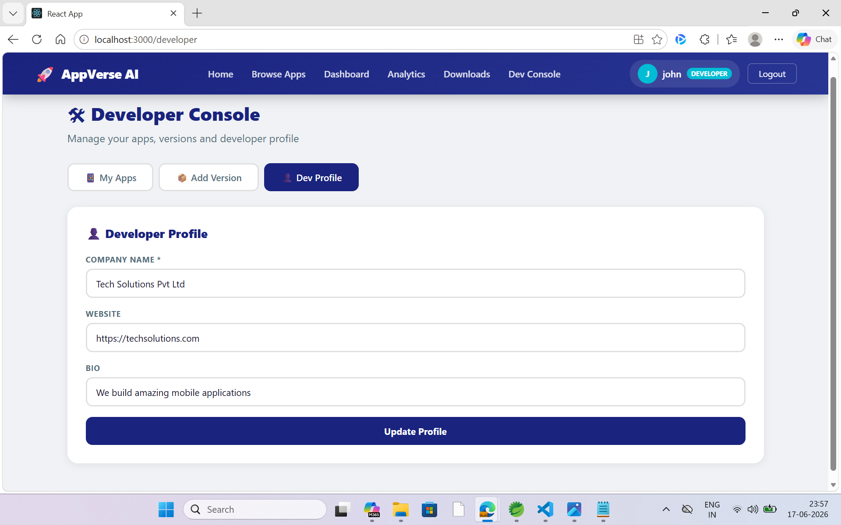

Slide 23
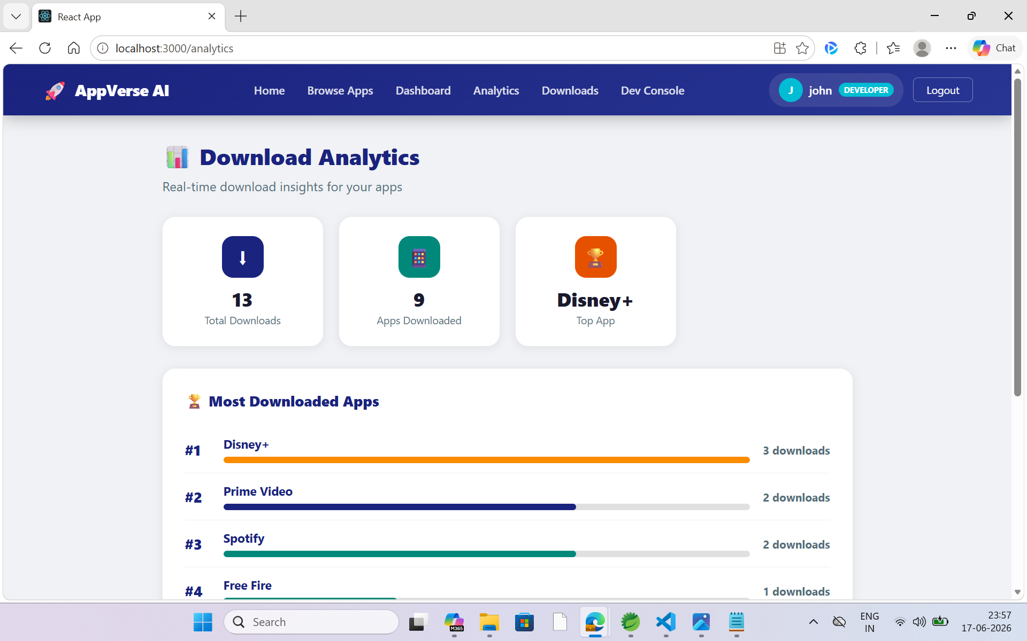

Slide 24
Future AI Enhancements
6 planned upgrades to make AppVerse AI smarter
AI App Recommendations
Auto Rating Calculation
Email on Download
Use each users download history to recommend new apps. If User A and User B download similar apps, suggest User A what User B also downloaded — collaborative filtering logic.
When a new review is posted, automatically recalculate and update the apps average rating. Currently averageRating is set manually in Postman.
Send an email alert to the developer whenever their app is downloaded. Implement using Spring Mail with Gmail SMTP configuration in application.properties.
Advanced Search Filters
Admin Charts Dashboard
Refresh Token Support
Add multi-filter search: filter by rating range, category, minimum downloads combined. Add sort options: newest first, most popular, highest rated.
Add bar and line charts to Admin Panel showing total downloads over time, monthly user registrations, most reviewed apps, and most active users.
Add refresh token so users stay logged in beyond 10 hours without re-entering password. When access token expires, use refresh token to get a new one automatically.
Notes:
Say: "For future enhancements I have planned 6 improvements. First, AI App Recommendations using collaborative filtering — suggest apps based on what similar users downloaded. Second, Auto Rating Calculation — currently I set average rating manually; I will make it auto-recalculate after every review. Third, Email Notifications using Spring Mail when an app is downloaded. Fourth, Advanced Search with combined filters. Fifth, Admin Charts showing registration trends and download patterns over time. Sixth, Refresh Token Support so the 10-hour JWT expiry does not force users to re-login."

